Slide 1
Incom Development ASX “Trading Wheels”
This document is intended for the supervisor
Group of:
Shane McLaws (s3436830) Callum Pullyblank (s3378543)
Zac Williams (s3431670) Sonia Varghese (s3484881)

Slide 2
Links
Repository:
https://github.com/rmit-s3436830-shane-mclaws/capstoneASX
This repository is public, and can be viewed (but not edited) by anyone.
Trello (Kanban Board)]
https://trello.com/b/gHRBQ18v
Again, this board is public, but only team members may edit.

Slide 3
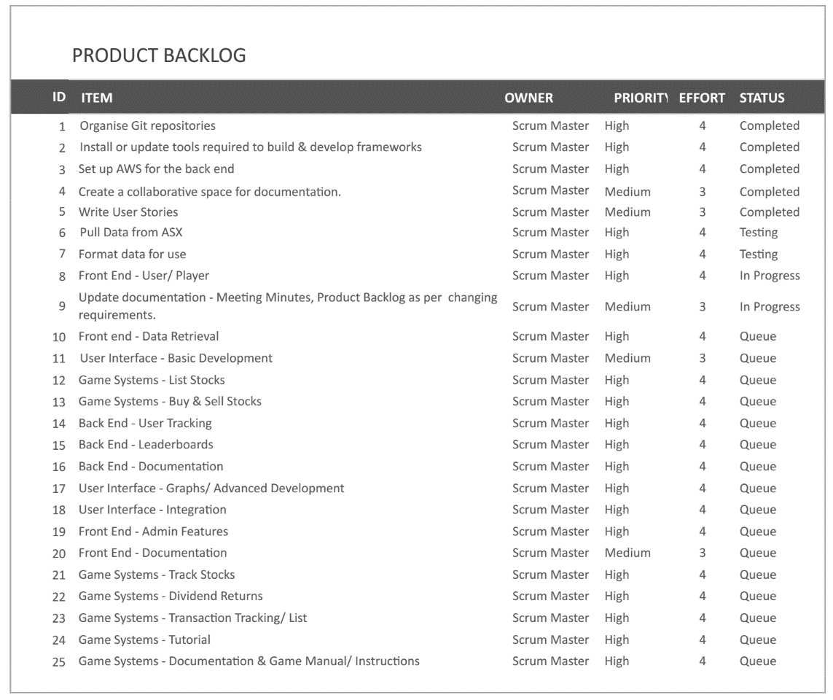

Slide 4
Storyboards
Storyboards are complete (or mostly complete)
They are available to view on our GitHub repository
Under (master/documentation/sprint1)
They are still in need of evaluation before UI development can begin

Slide 5
Development
Development of both front-end and back-end is underway.
Amazon AWS s3 buckets are prepared and EC2 instances are running
Stock information is being saved to S3 bucket successfully
Development of user login system is underway
Front-end is currently command-line based to set up the required classes and calls for when the UI is in development.
Loading and saving player to local locations is ready and editing of player details is ready

